Slide 1

NFC Pedometer & Location Based Social Game for Tourists
Nakayama Angelica

Slide 2
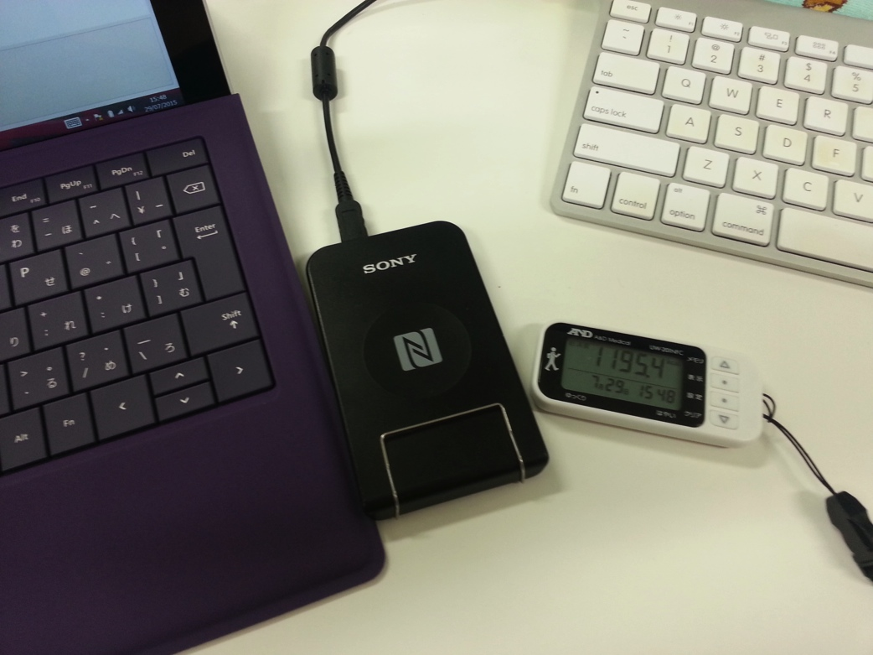
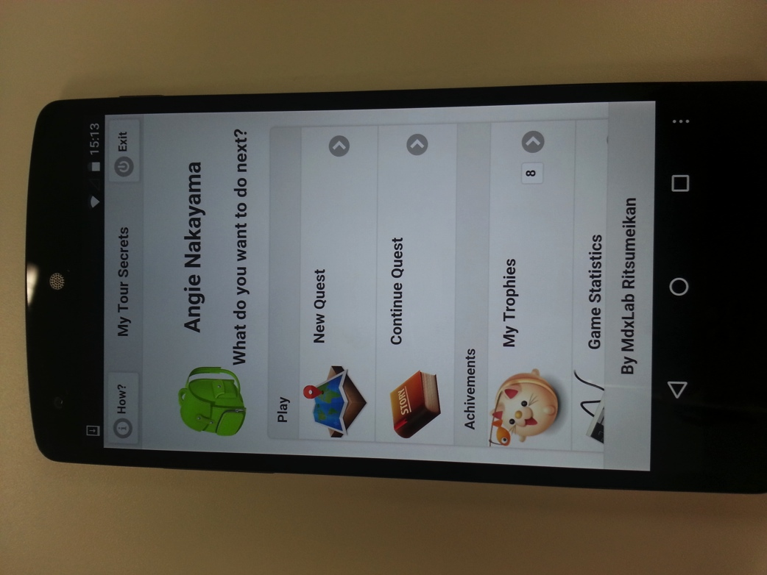
NFC Pedometer
Location Based Social Game for Tourists
for Tekupeko project
(May ~ Aug)
(Aug ~ Oct)
Notes:
During my stay on Ritsumeikan University I worked on two different projects:
First on the NFC Pedometer for Tekupeko (From May to August)
And the second is a Location Based Game focused on tourism (From August to October)

Slide 3

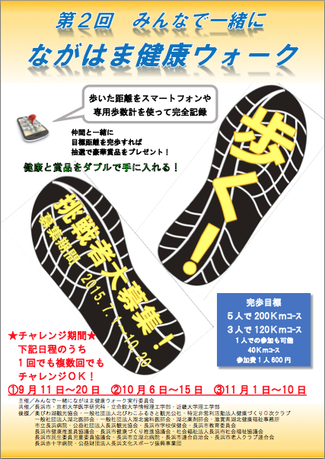
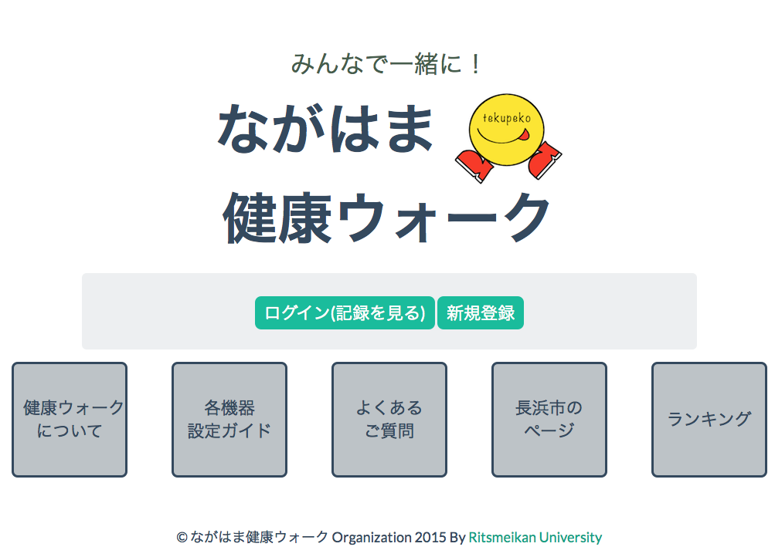
NFC Pedometer for Tekupeko
Notes:
Tekupeko is a project for making people walk more using mobile technologies (smartphones).
This project was developed in Multimedia Experience Laboratory (by Suzuki san and Wakao san) it was used last year (and also this year) on a walking for health event.
Android and iPhone app already developed and in phase of redesign and improvement.
There is also a webpage where you can register and see your progress, make teams, etc.

Slide 4
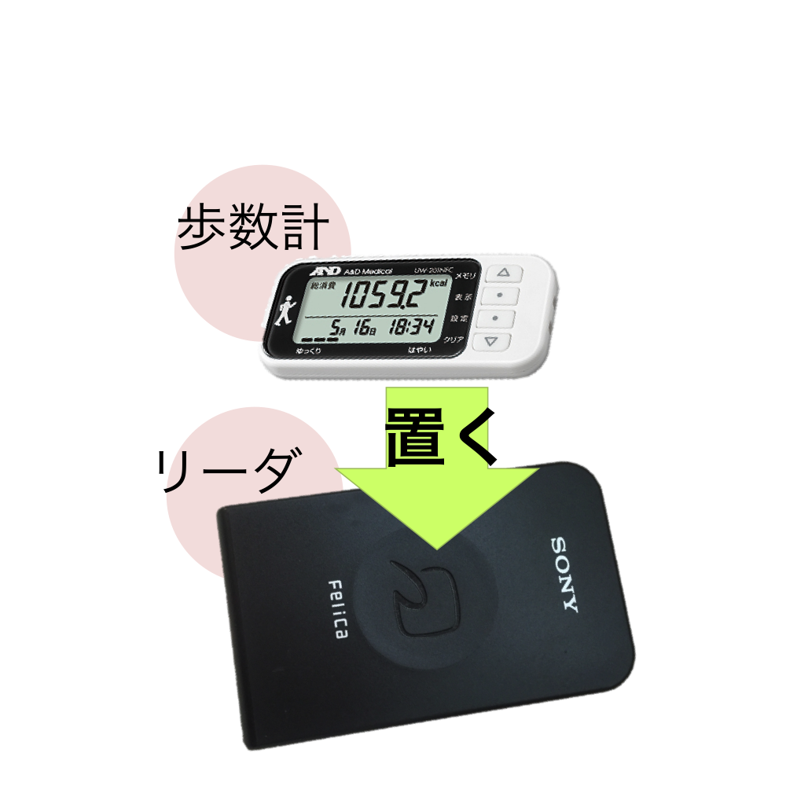
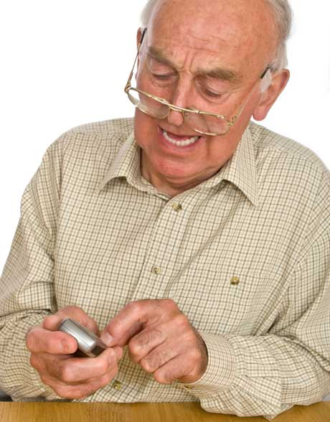
NFC Pedometer
But what about people without smartphones?
Notes:
By using a NFC pedometer we can make this people to enter the event.
No need to buy a expensive device and learn complicated things to use it.
Just carry the device on their pocket and go to registration point once a while.
Using NFC technology we can transfer walking data from pedometer to the event website.

Slide 5
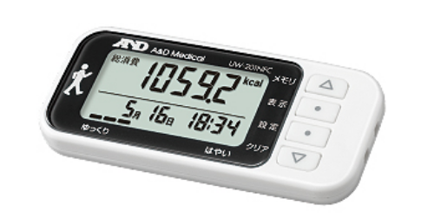
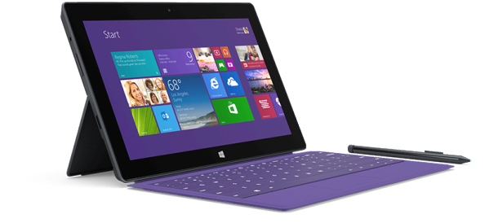
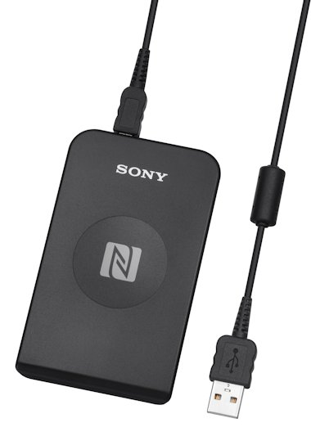
Hardware
NFC Pedometer
A&D Medical UW-201NFC
NFC reader
Sony RC-S380
PC
Windows Surface Pro 3

Slide 6
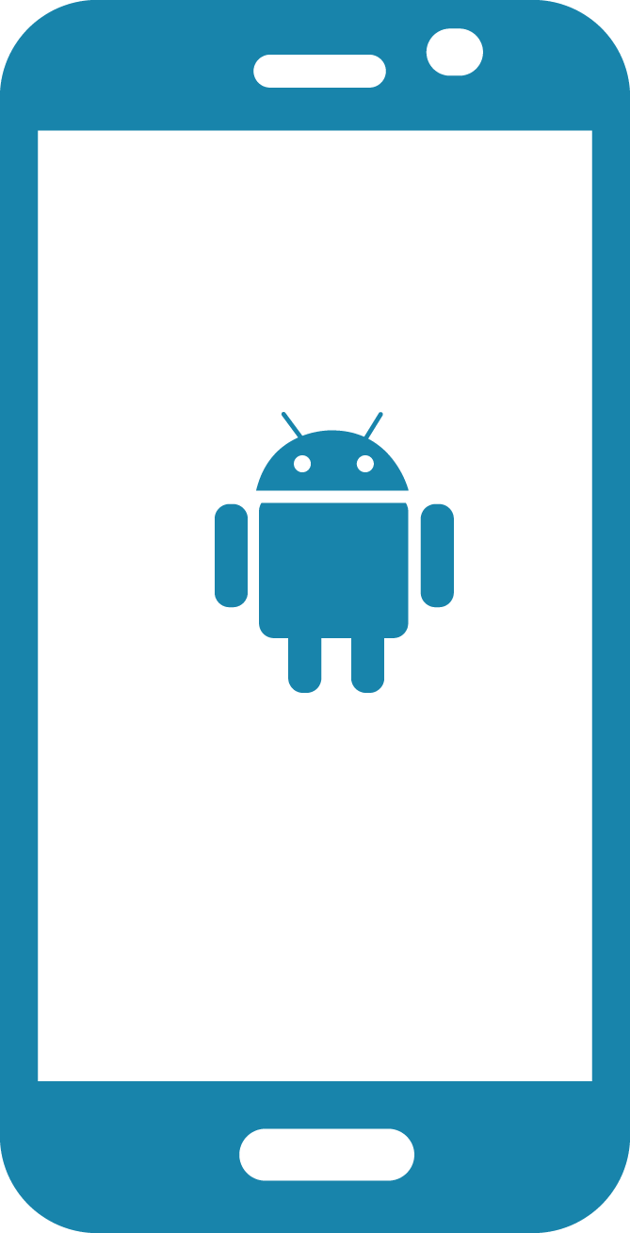

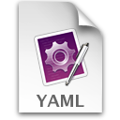


Django
Tekupeko server
Pedometer
Reader
Android
Tekupeko app
Moves Relay App
GIT
Server
Moves
Server
YAML
File
PC app
Notes:
This is the diagram of the system’s design, they asked me to help with the pedometer part, they already had the mobile app, servers and they were working on a improvement of this versions.

Slide 7
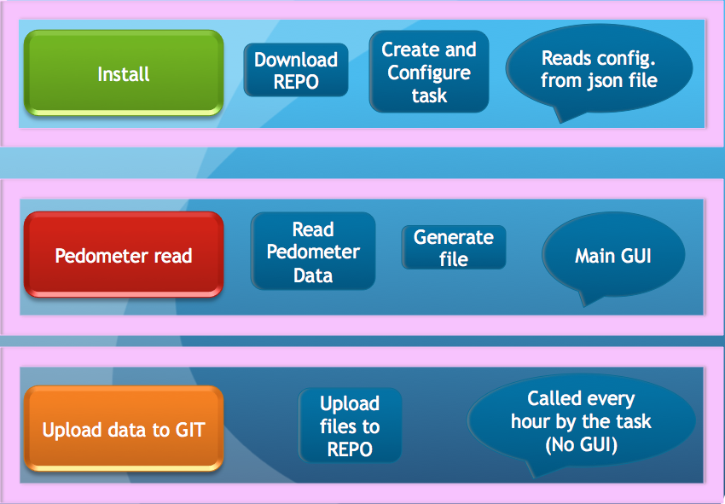
General design

Slide 8
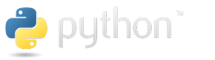



Programing
Python 2.7 & C (Programing language)
NFCPY Library for Python and NFC (open source)
Git (Version Control System) Github server (testing)
Sony NFC Port Software (Driver for RC-S380 freeware)
Sony SDK for NFC Starter Kit (freeware)
Sony NFC Healthcare Library (request and registration to use )

Slide 9
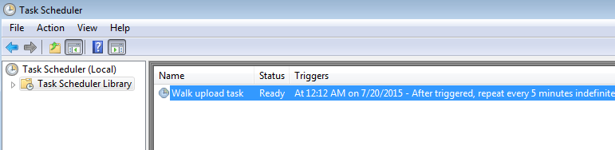
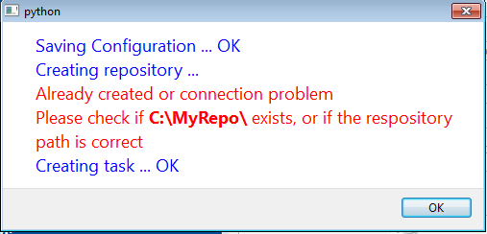
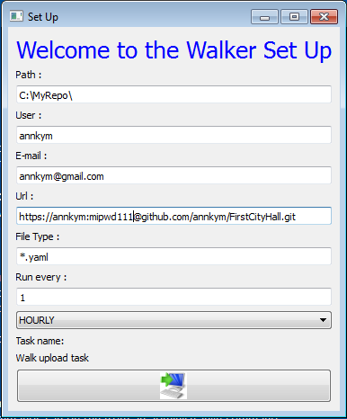
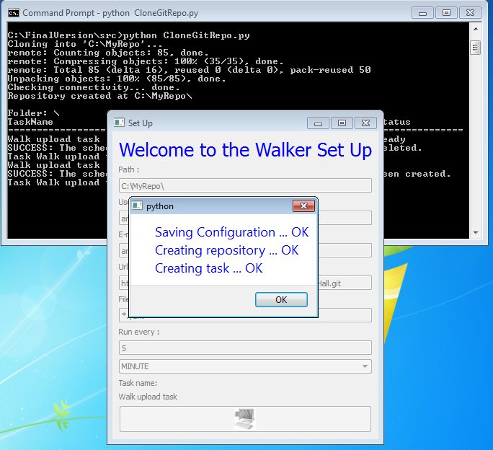

Slide 10
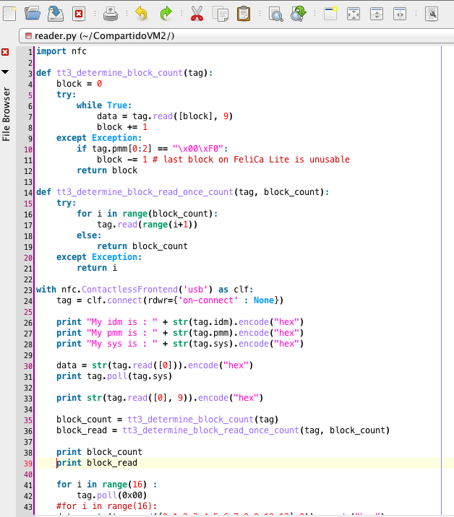
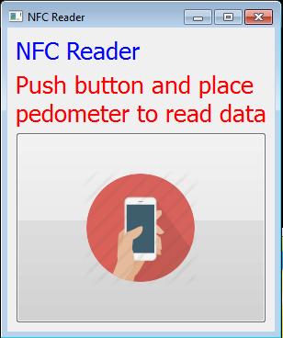
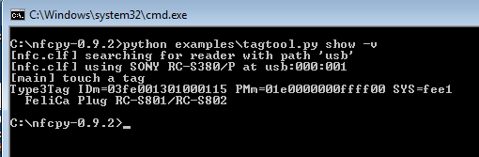
Notes:
First attempt, NFCpy library for python
Difficult to read data, read blocks, and translate it to pedometer data… complicated!

Slide 11
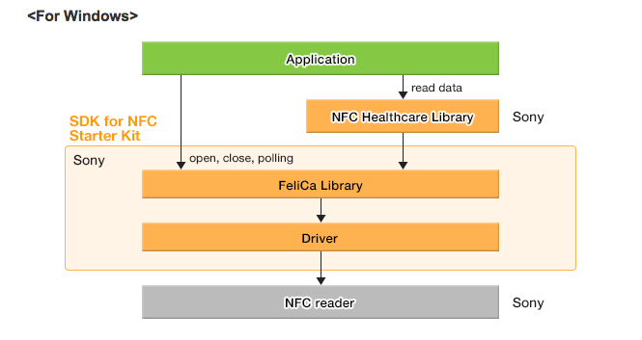
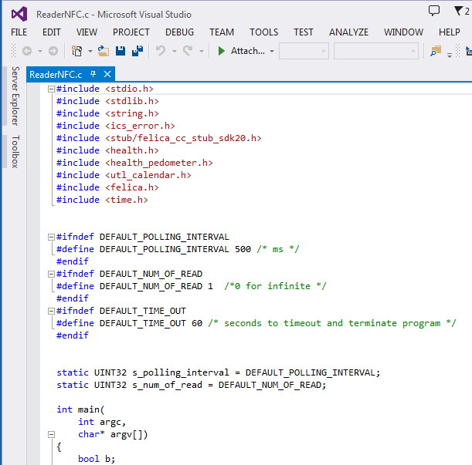
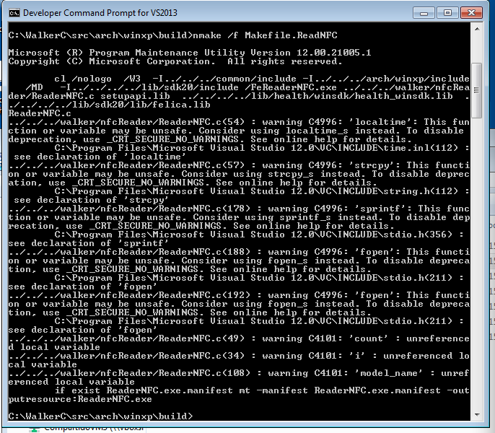
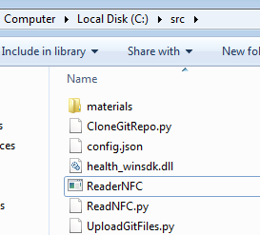
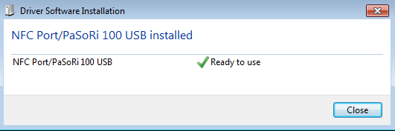
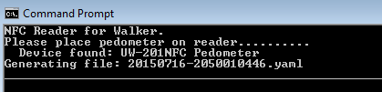
Notes:
Redesign of reader
Using :
Sony NFC Port Driver
Sony SDK for NFC
Sony NFC Healthcare Library
Programing with C and Visual Studio

Slide 12
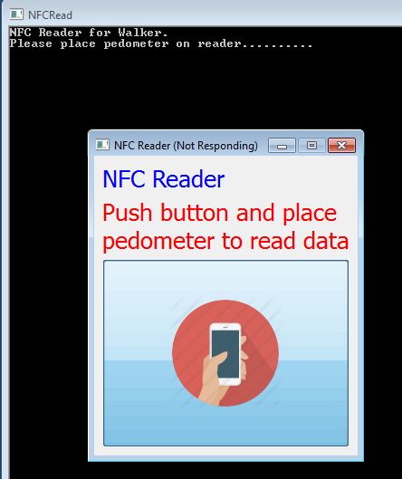
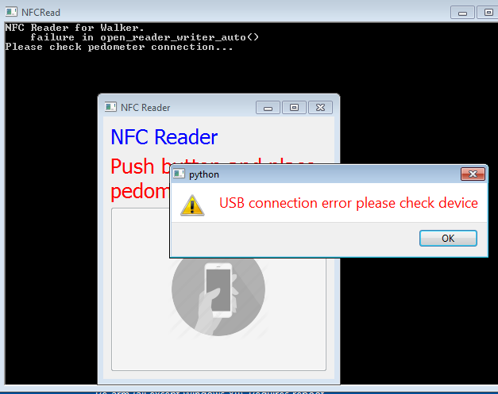
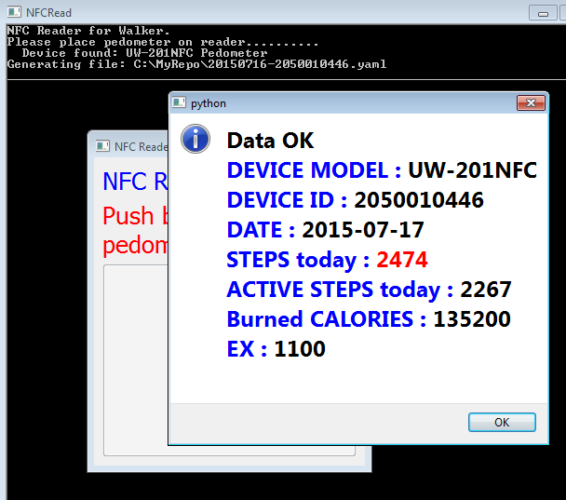
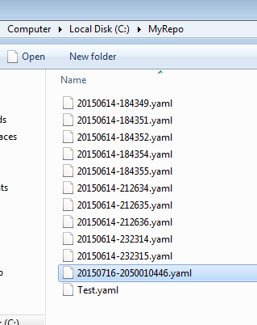

Slide 13
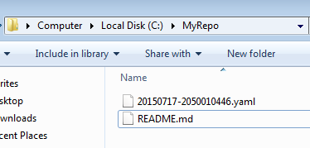
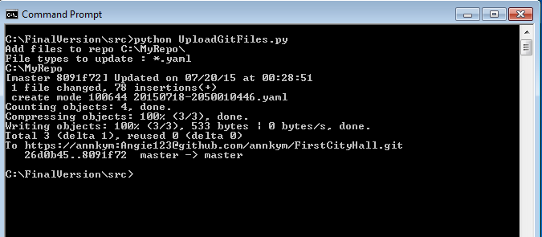
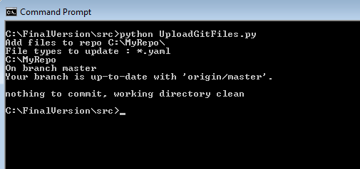
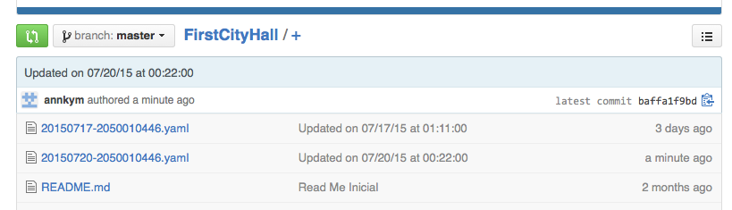

Slide 14
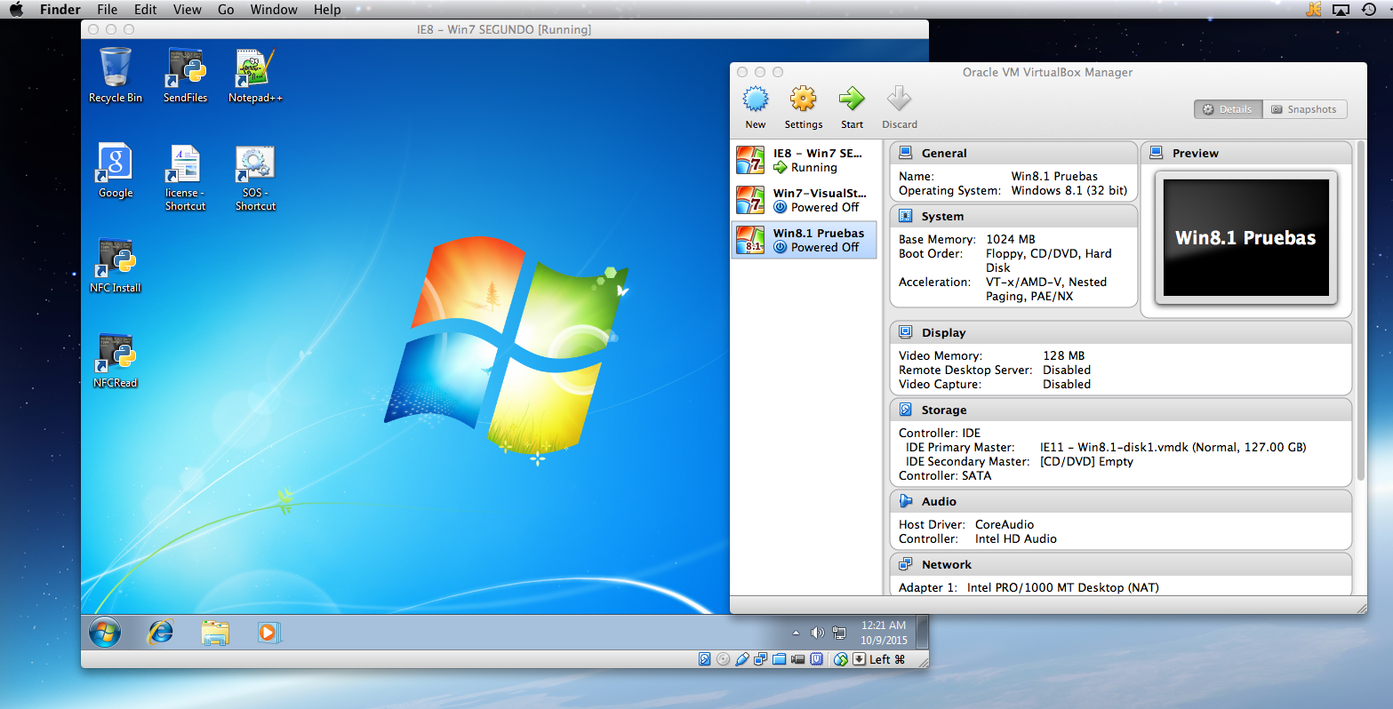
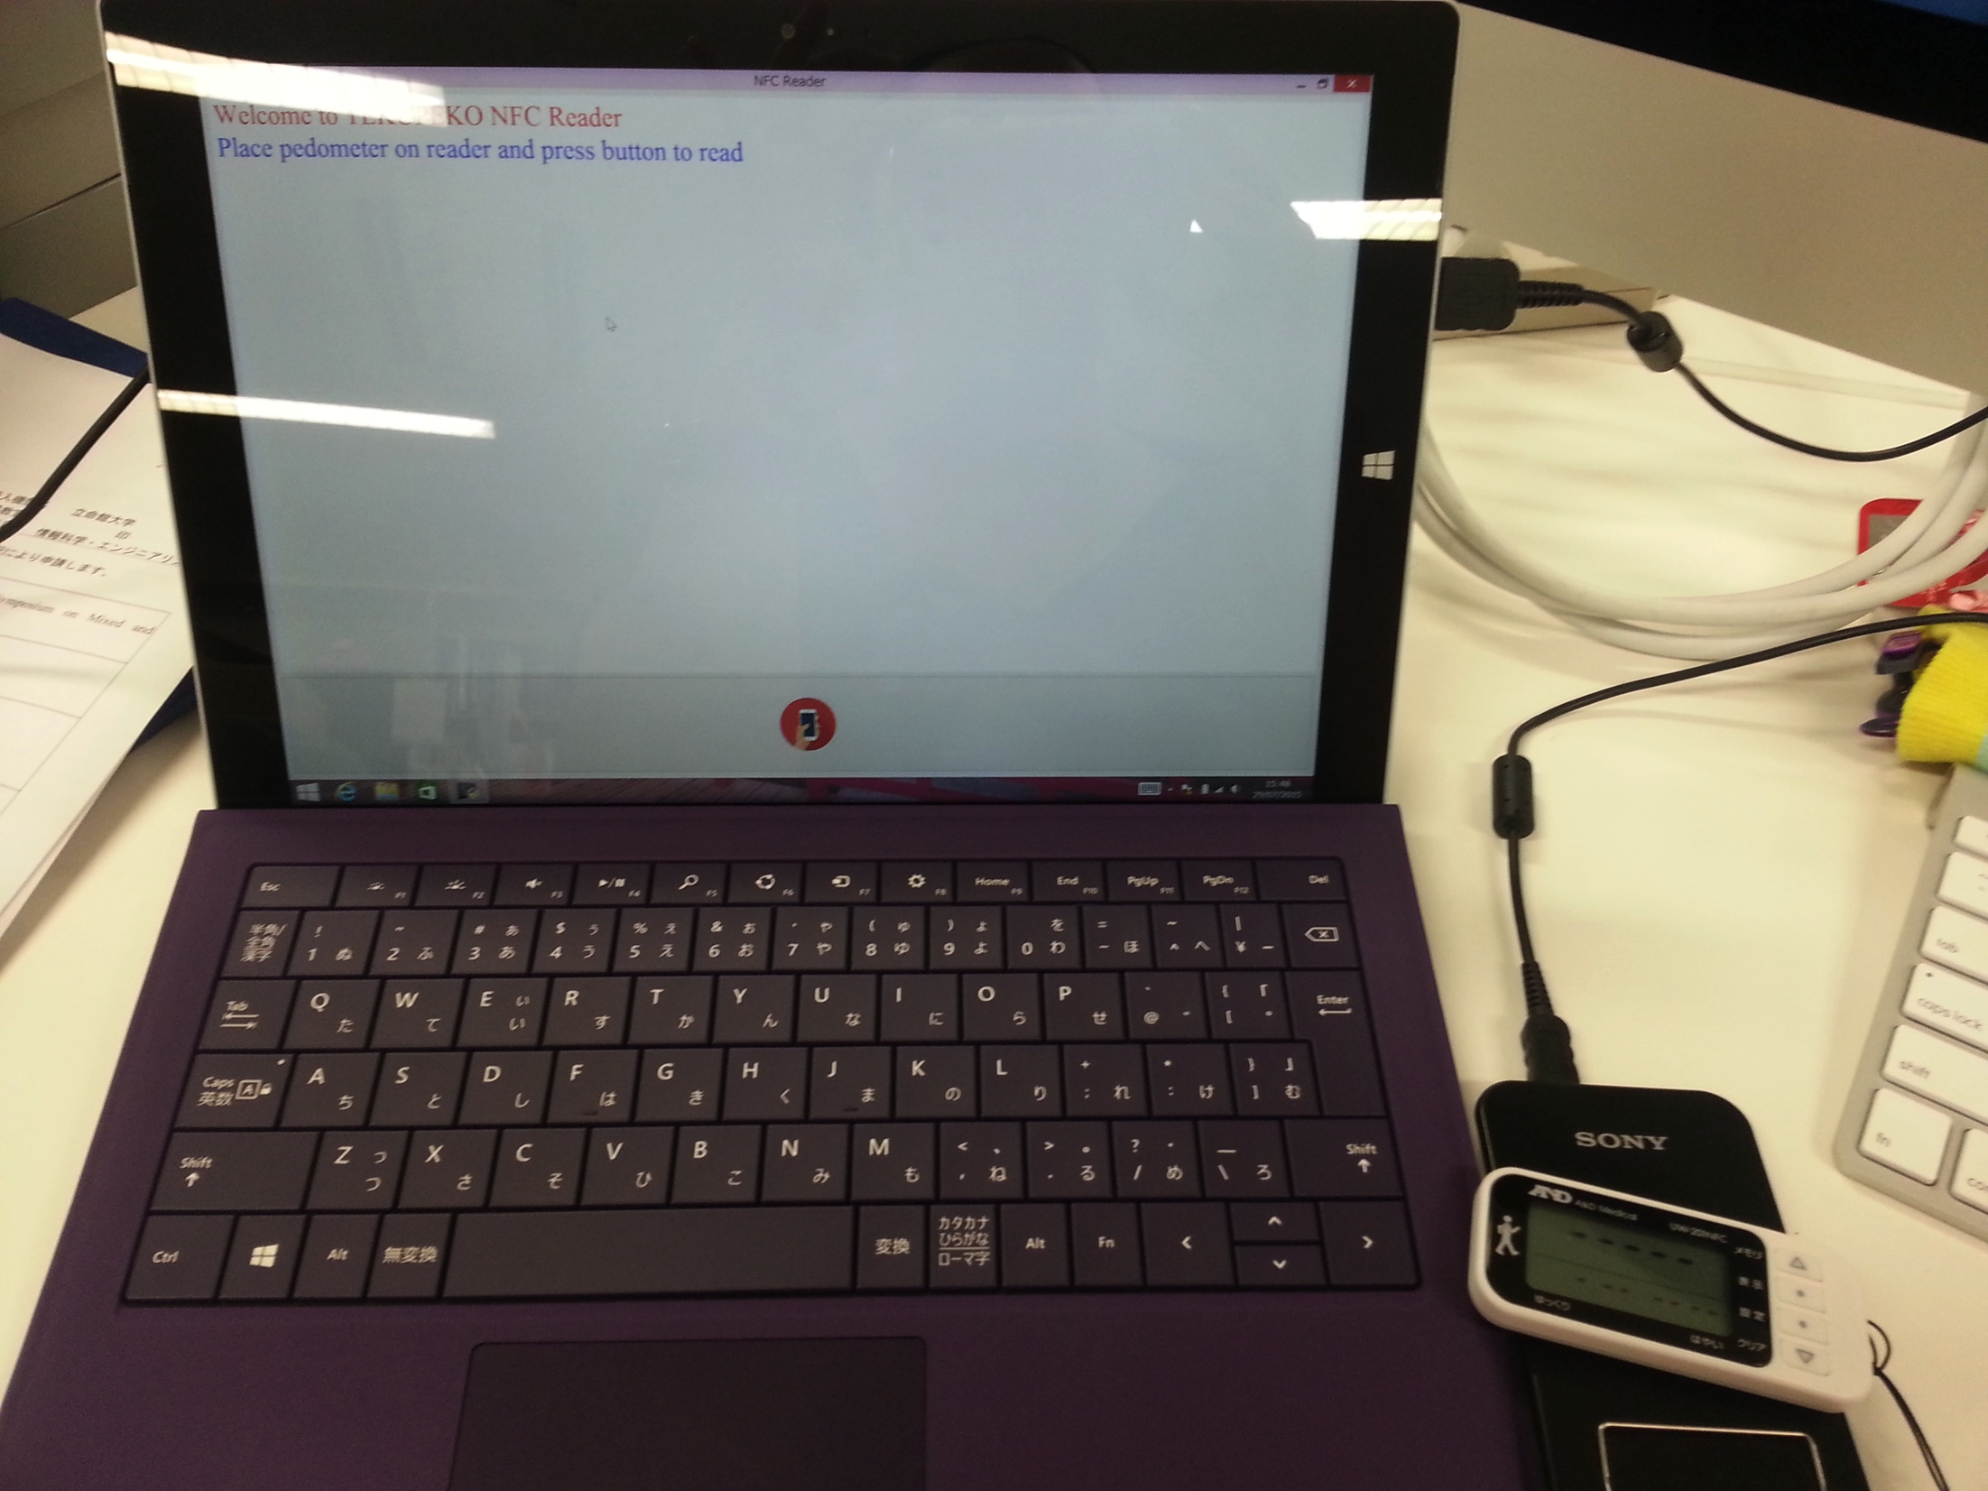
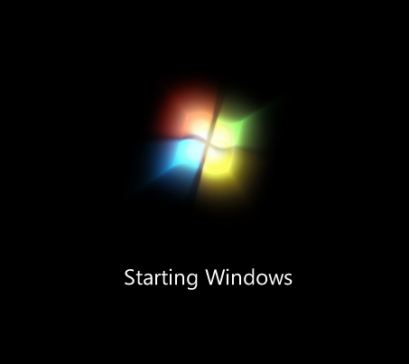
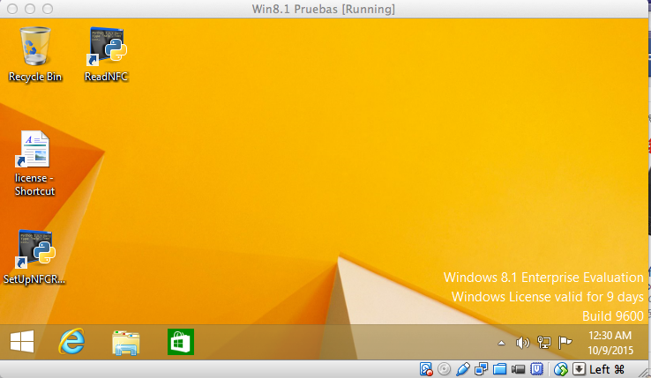
Testing
Virtual box
Virtual machine Windows 7 & 8
Final testing on Windows surface PRO 3 with Windows 8

Slide 15
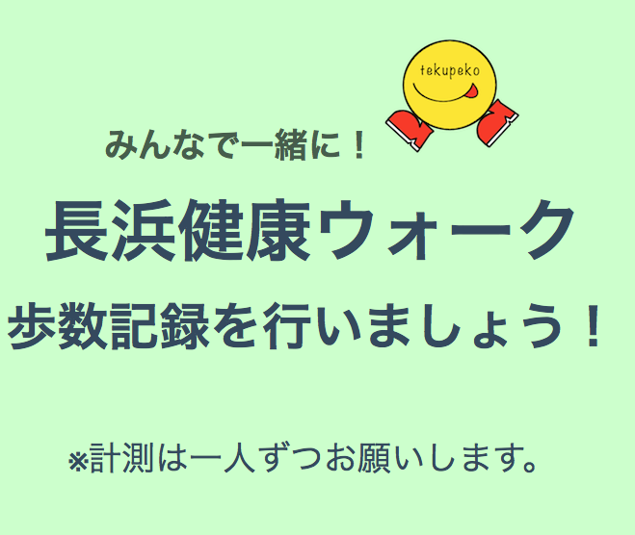
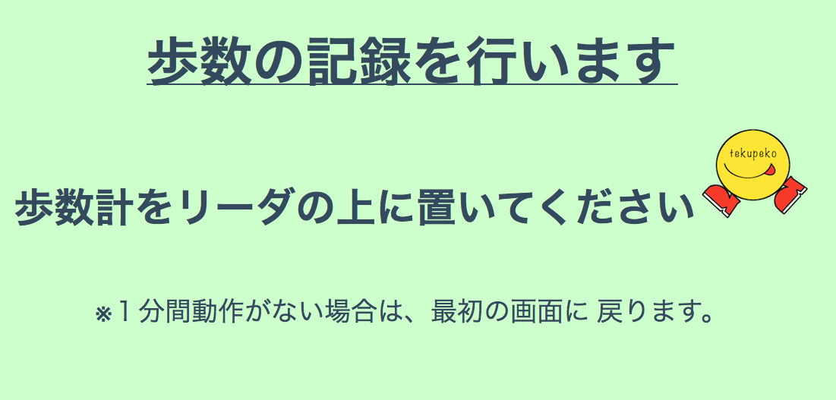
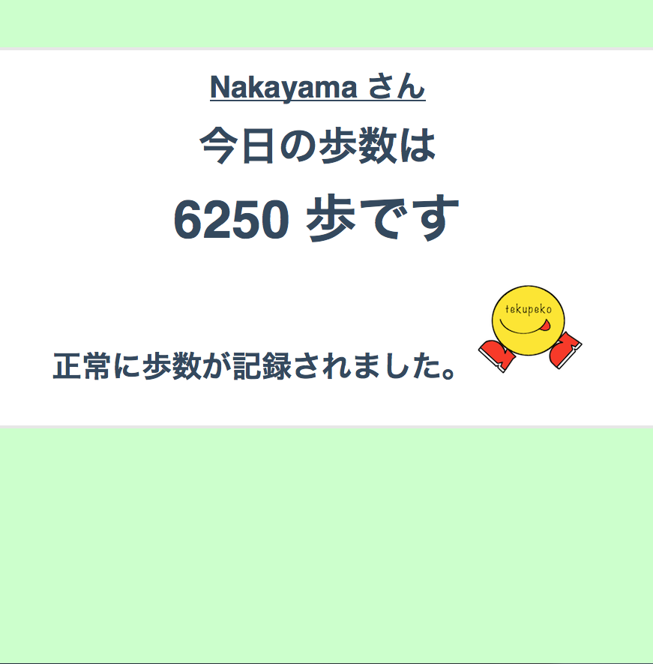
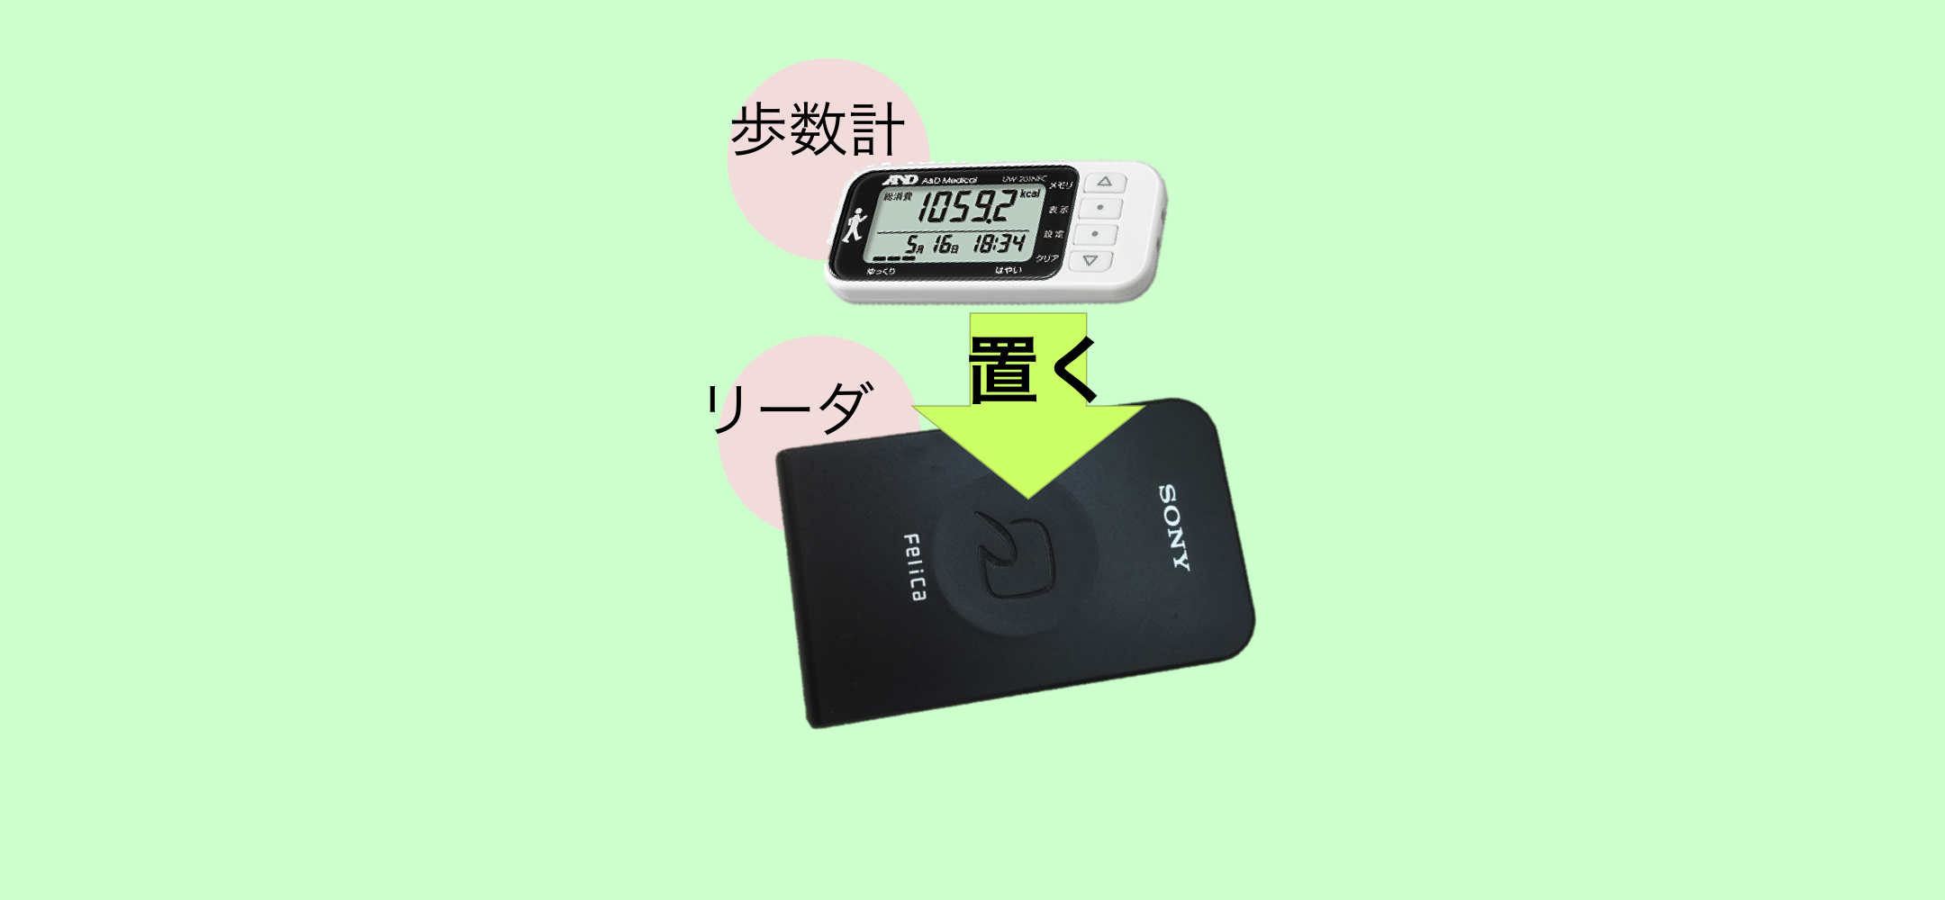
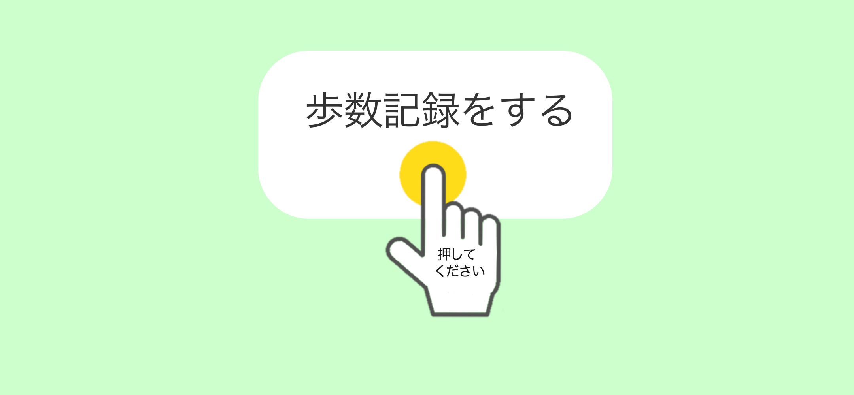
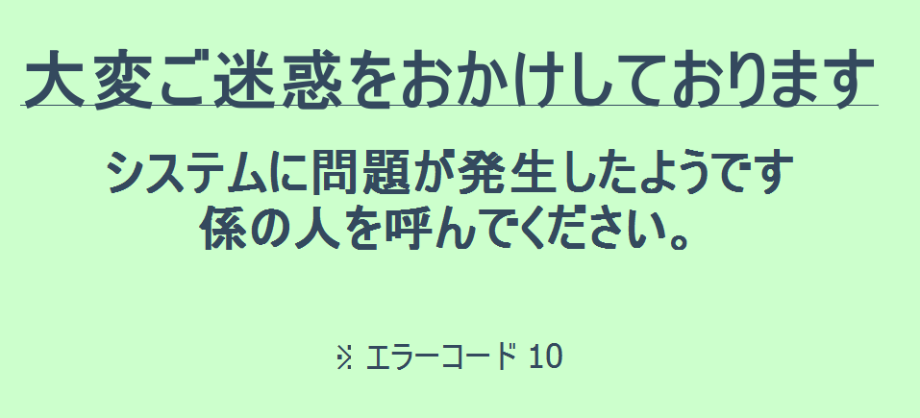
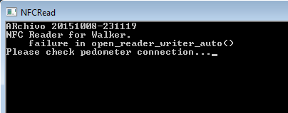
Final GUI design for walking event
Notes:
Change the GUI to be in Japanese and web based design.

Slide 16
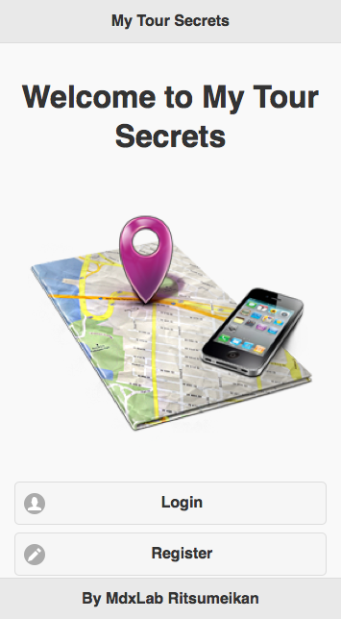
Location Based Social Game for Tourists
A location-based game (LBG) is a type of game where the experience is extended out in the real world and the gameplay evolves and progresses via a player's location (by GPS).
LBG may induce learning.
Notes:
http://everybodywalk.org/documentary/

Slide 17
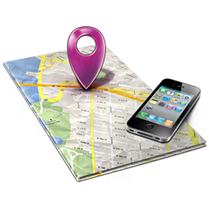


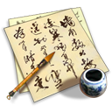
Why?
The purpose of this game is to make people know more about sights and learn interesting facts about them.
To have fun while traveling, enjoy the secrets that tourist places have and to share it with friends.

Slide 18
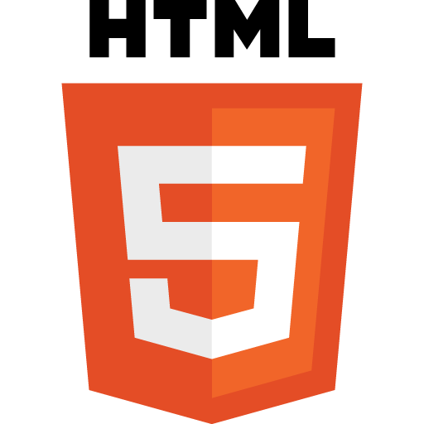
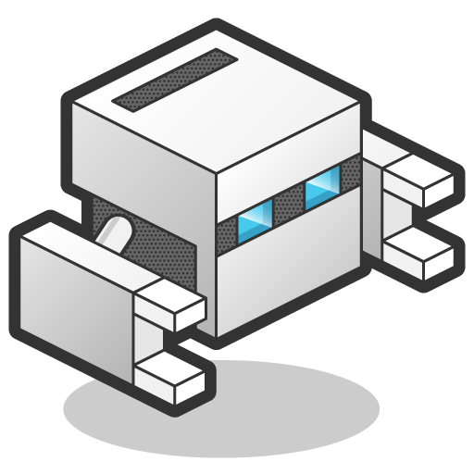





Design &Technology
HTML 5
PhoneGap
JQuery & JQuery Mobile
PhoneGap Build
Google Maps api for JS

Slide 19








Slide 20










Slide 21











Slide 22







Slide 23



Future work
Add social sharing (Invite friends, share on Facebook, Twitter, etc.)
Customizable routes
Play on teams

Slide 24
Thank you!!!
Q & A

Slide 25

NFC
Additional notes
NFC (Near field Communication) is the set of protocols that enable electronic devices to establish radio communication with each other by touching the devices together, or bringing them into proximity to a distance of typically 10cm or less
Each full NFC device can work in three modes:
NFC Card emulation mode enables NFC-enabled devices such as smartphones to act like smart cards, allowing users to perform transactions such as payment or ticketing.
NFC Reader/writer mode enables NFC-enabled devices to read information stored on inexpensive NFC tags embedded in labels or smart posters.
NFC peer-to-peer (P2P) mode enables two NFC-enabled devices to communicate with each other to exchange information in an adhoc fashion

Slide 26

NFC Tags
NFC tags typically contain data and are read-only, but may be rewritable. NFC tags can be custom-encoded by their manufacturers or use the industry specifications provided by the NFC Forum.
NFC Forum defines 4 distinct types of tags that provide different communication speeds and capabilities in terms of flexibility, memory, security, data retention and write endurance.
Type 3 Tag is based on the Japanese Industrial Standard (JIS) X 6319-4. This tag type is pre-configured at manufacture to be either read and re-writable, or read-only. Example: Sony FeliCa

Slide 27







Sony FeliCa & PaSoRi
FeliCa is a contactless RFID smart card system from Sony in Japan, used in e-money, public transportation, and student id cards (ICCOCA, Suica, Manaca, PiTaPa, etc.) as well as in consumer electronics.
The name stands for Felicity Card
Sony has an external USB FeliCa PC reader/writer called PaSoRi. (Sony RC-S380)

Slide 28


A&D NFC Pedometer
UW-201NFC
Notes:
NFC Dynamic Tag is a wireless-interface product, which can be embedded into electronic devices, enabling the device to communicate with any NFC reader/writer or with any NFC smartphone
http://www.sony.net/Products/felica/casestudy/healthcare.html

Slide 29





Notes:
Python 2.7 Anaconda Distribution
Python libraries QtPy, pyside,nfcpy, libusb, apscheduler
Git command prompt
NFC usb driver with libusb-win32

